Slide 2
Shear center of C section
Consider a C section. It is an example of a cross section with one axis of symmetry.
The shear load is vertical
It is required to find a point P on the z axis through which the shear force must pass so that the overall internal forces generated do not cause the section to twist. Flange width t is negligible as compared to other dimensions.
y
B
A
z
O
h
P
C
D
b

Slide 3
Shear center of C section
y
The coordinate system is chosen with the origin at the centroid O.
The z axis is chosen to be along the axis of symmetry.
Y axis is vertically upwards.
X axis is along the length f the beam (out of the plane of the paper).
B
A
z
O
h
C
D
b

Slide 4
Shear center of C section
y
The overall internal forces generated are such that they do not cause the section to twist.
This can only happen when the moments of the internal forces balance the moment of the external load.
B
A
z
O
h
C
D
b

Slide 5
Shear center of C section
y
We need to find out first the I about z, which we can simplify by considering the smallness of t.
B
A
z
O
h
C
D
b

Slide 6
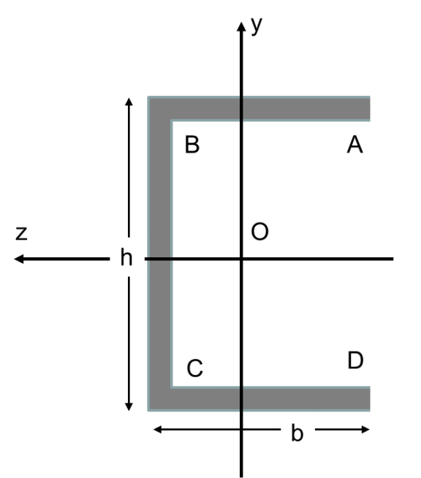
Segment AB
s
We choose a small area (yellow) of width ds at distance s from A.
First we need to find the shear stress in this area.
So we make a vertical cut and consider the area (red) behind the cut.
We can find Q for this area

Slide 7
Segment AB
s
Once we find Q we can find the shear stress at a distance s from A

Slide 8
Segment AB
s
We can now find the force in segment AB by integrating this shear stress for the entire area from A to B

Slide 9
Segment BC
We choose a small area (yellow) of width ds at distance s from B.
First we need to find the shear stress in this area.
So we make a horizontal cut and consider the area (red) above the cut.
We can find Q for this area
s

Slide 10
Segment BC
Once we find Q we can find the shear stress at a distance s from B
s

Slide 11
Segment BC
We can now find the force in segment BC by integrating this shear stress for the entire area from B to C
s
s

Slide 12
Segment BC
Let us put the value of Izz
So this vertical force is equal but opposite to the external vertical force!
s
s

Slide 13
Segment CD
We choose a small area (yellow) of width ds at distance s from C.
First we need to find the shear stress in this area.
So we make a vertical cut and consider the area (red) before the cut.
We can find Q for this area
s

Slide 14
Segment CD
Once we find Q we can find the shear stress at a distance s from C
s

Slide 15
Segment CD
We can now find the force in segment CD by integrating this shear stress for the entire area from C to D
s
s

Slide 16
Force equilibrium
y
We now have a complete picture of internal shear forces.
Let P be at a distance e from BC.
F_{BC} balances the external force
F_{AB} balances F_{CD}
Hence force equilibrium is maintained
B
A
z
O
h
P
C
D
e
b

Slide 17
Moment equilibrium
y
To simplify calculations we choose a point where maximum number of forces intersect. B and C are two choices.
We choose C.
Hence F_{AB} and F_{CD} play no role
B
A
z
O
h
P
C
D
e
b

